Slide 1
Car Rental Presentation
Jason Tran
Benjamin Yang
Ethan Luu

Slide 2
Project Overview
Main Objective: Allow users of our website to register a profile, retrieve information about cars available for rent, as well as grant them the option to rent them at hourly rates.

Slide 3
System Requirements
The system shall provide an interface to look through a catalog of available cars to rent.
The system shall display information about the cars as well as the hourly rates to rent them.
The system shall allow the user to register their profile on the website by inputting their information and make rentals based on an hourly rate.

Slide 4
Data Requirements
Three Entities: User, Car, Transaction
Users must have a unique identification number, name, email, password, username, phone number, time registered, and address
Cars must have their own unique identification number, make, model, year of that model, color, and price of their hourly rates
Transactions must include both car and user IDs as well as the ID number of that transaction, the time the car was rented and the rate chosen.

Slide 5
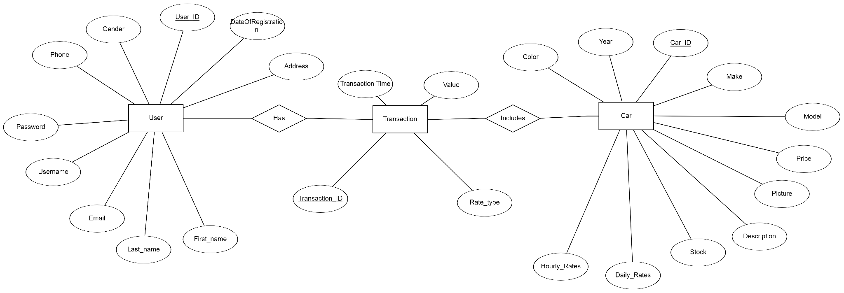
Entity Relationship
1
N
N
1

Slide 6
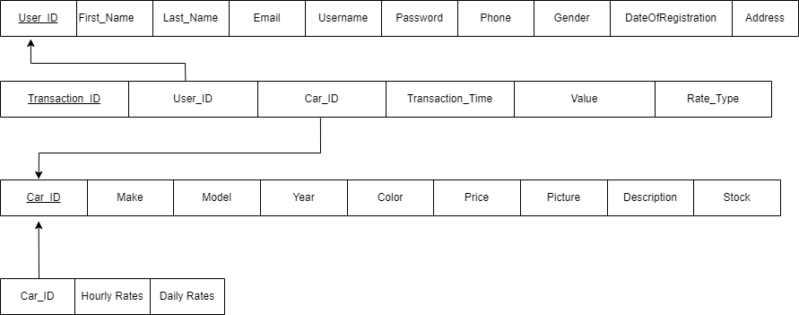
Relational Database Diagram

Slide 7
Website
http://ecs.fullerton.edu/~cs332s32/index.php

Slide 8
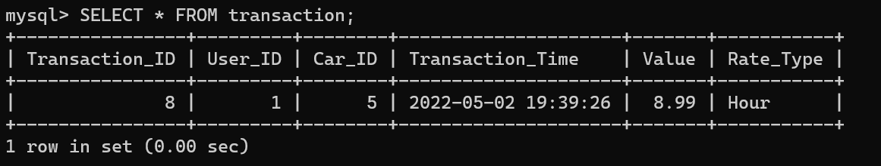
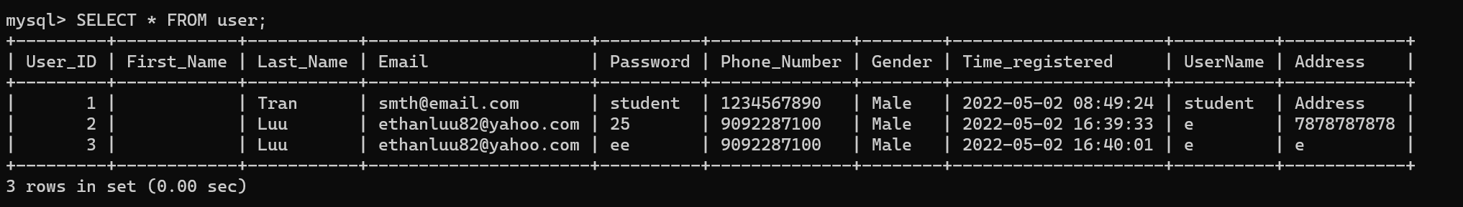

Slide 9
Lessons Learned
Learned how to integrate SQL with PHP to design a website that uses a database for information storing
Learned how to use Bootstrap to enhance UX on the website
Learned how to connect variables across different pages
Learned how to code with PHP, HTML, and CSS in one file
Remember the name of your database
DO NOT put spaces in any names

